Slide 1
FloCon 2018 Tucson AZ
x January 2018
Analysis of DNS Traffic on the Network EDGE, and In Motion.
Fred Stringer

Slide 2
Key Messages
Distributed Analysis (at the collection points) enables scale, flexibility and timely indicators.
Streaming analysis enables near real time detection from multiple algorithms with one packet capture and parsing.
Machine learning algorithms with data in motion are accurate and effective.
More accuracy is achieved with some analysis work, managing block/ignore lists.
COTS commodity hardware is capable of handling respectable volume of traffic ~4Gb/s
Notes:
Thank you Flocon conference staff for selecting my talk and enabling me to share.
Let’s start with what we have learned and what I think is of value to you – why I wanted to give this talk.
Those of you reading and writing intelligence briefs in the BLUF format will recognize this – my starting with the bottom lines first.

Slide 3
Two More Observations
Analysis of DNS activity provides insights into security relevant activity that you may not have anticipated.
Traffic analysis provides indicators not seen anywhere else.
This is Flocon , you all knew that.
Notes:
Thank you Flocon conference staff for selecting my talk and enabling me to share.
Let’s start with what we have learned and what I think is of value to you – why I wanted to give this talk.
Those of you reading and writing intelligence briefs in the BLUF format will recognize this – my starting with the bottom lines first.

Slide 4
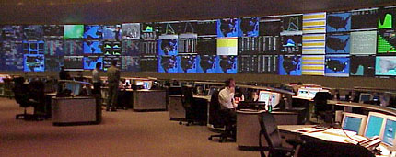
Threat Analytics Platform 1.5
Remediation coordination
Reporting & Analysis
Systems
Forensic Analysis
GNOC
Alerts
Data Acquisition
Data Collector
Transport
Storage, Processing, Analysis
Reporting Analysis & Alerting
Interpretation & Response Processes
Central
Analysis
Platforms
Source: AT&T Cyber Security Strategy presentation

Slide 5
Threat Analytics Platform 2.0
SOCs
Remediation coordination
Ops Centers
Forensic Analysis
Reporting & Analysis
Systems
GNOC
Alerts
Interpretation & Response Processes
Data Acquisition
DNS Collector 2.0
w/ Streaming
Analytics
Transport
Storage, Processing, Analysis
Reporting Analysis & Alerting
Central
Analysis
Platforms
Source: AT&T Cyber Security Strategy presentation

Slide 6
Valuable Security Analysis of DNS Activity 1/3
Tunneling and other non-DNS over port 53
Detect compromised hosts potentially exfiltrating data.
DGA Detection
Identify hosts with indications they are participating in a Botnet
Squatting Detection
Identify domains which are impersonating legitimate domains. Often used in phishing attacks.
Outlier Detection and Volumetric Anomaly Detection.
Indicates a pattern change. Typically prompts additional automated correlation and can reinforce (add confidence level) another indicator.
Source: AT&T DNS Collector 2.0 Feature Description

Slide 7
Valuable Security Analysis of DNS Activity 2/3
DrDos – Distributed Reflective Denial of Service
Identify hosts being DDoS attacked, typically Identifies a spoofed address – entry of which is often traced to misconfiguration.
Detect of open resolvers.
“Dark DNS” - rogue DNS infrastructure
DNS changer and more.
Detection of DNS infrastructure outside of the Internet hierarchy typically used for control of malicious activities.
Indicates hosts communicating have been potentially compromised
Source: AT&T DNS Collector 2.0 Feature Description

Slide 8
Valuable Security Analysis of DNS Activity 2/3
DNS NXDOMAIN and Subdomain exhaust
DoS attack of the DNS impairing service to all users.
DNS clients often spoofed and/or compromised host.
Newly Observed Domains (NOD)
Useful indicator to correlate with other indicators.
Can give NOD a low reputation score initially
If today’s NOD was and DGA NXDOMAIN yesterday it is strong indication of roving C2 of a DGA Botnet.
Source: AT&T DNS Collector 2.0 Feature Description

Slide 9
DNS Collector 2.0 - Probe / Collector / Analyzer
Collector 1.0 Functionality
DNS Analytics running in DNS 2.0 Collector today:
Tunneling
DGA
Volumetric Outlier Anomaly Detection
Port 53 Abuse: DNS Malformed and DNS Flags Validation
File Format
Normal Answer File Output
File Format
Error Response File Output
File Format
Malformed File Output
File Format
Non- DNS File Output
DNS Packet Ingest & Parse
IP Address
Interest
Lists
Indicators
DGA Filter
Feature Extraction
Analytic Model
File Output
Tunnel Filter
Feature Extraction
Analytic Model
File Output
Volumetric
Sampling
Forecasting
Anomaly Detection
File Output
Metrics
File Output
Source: AT&T DNS Collector 2.0 Training presentation

Slide 10
Take-Aways
Distributed Analysis (at the collection points) enables scale, flexibility and timely indicators.
Real time streaming analysis on the network edge enables detecting multiple indicators simultaneously
Correlating indicators can strengthen the confidence level.
Machine learning algorithms not just for data at rest
COTS commodity hardware is capable of handling respectable volume of traffic ~4Gb/s
DNS Collector 2.0 can run as NFV in a VM at lower DNS traffic volumes.
Analysis of traffic is always interesting, often revealing and effective means of detecting Threat Indicators.

Slide 11
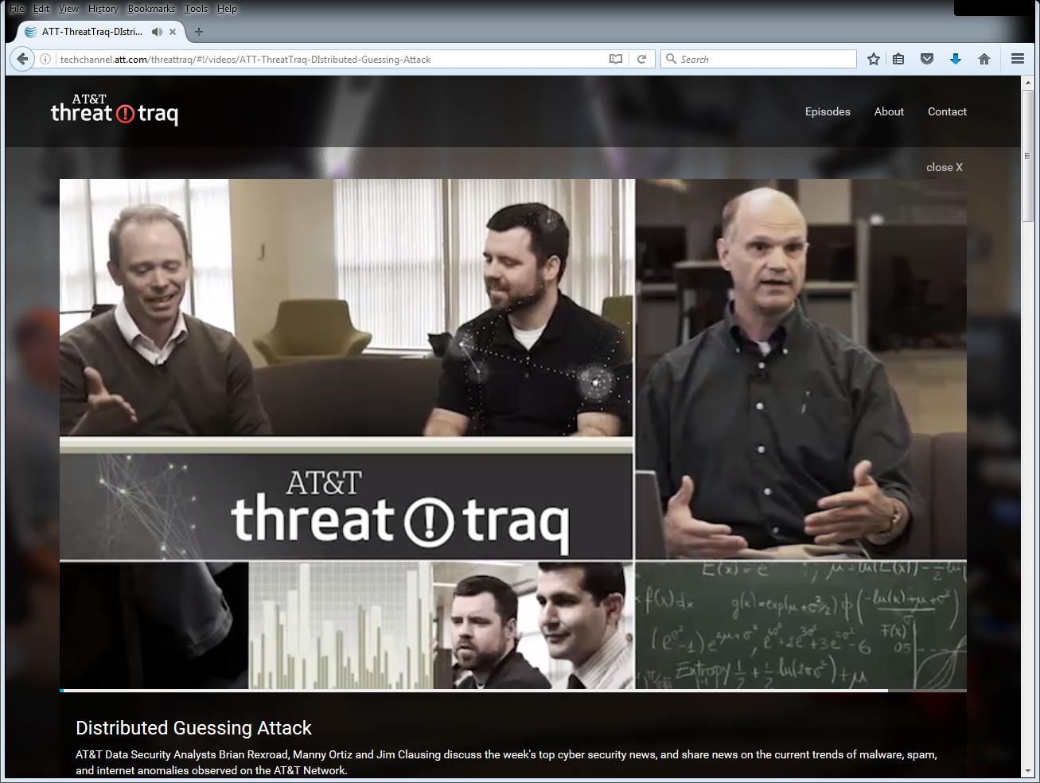
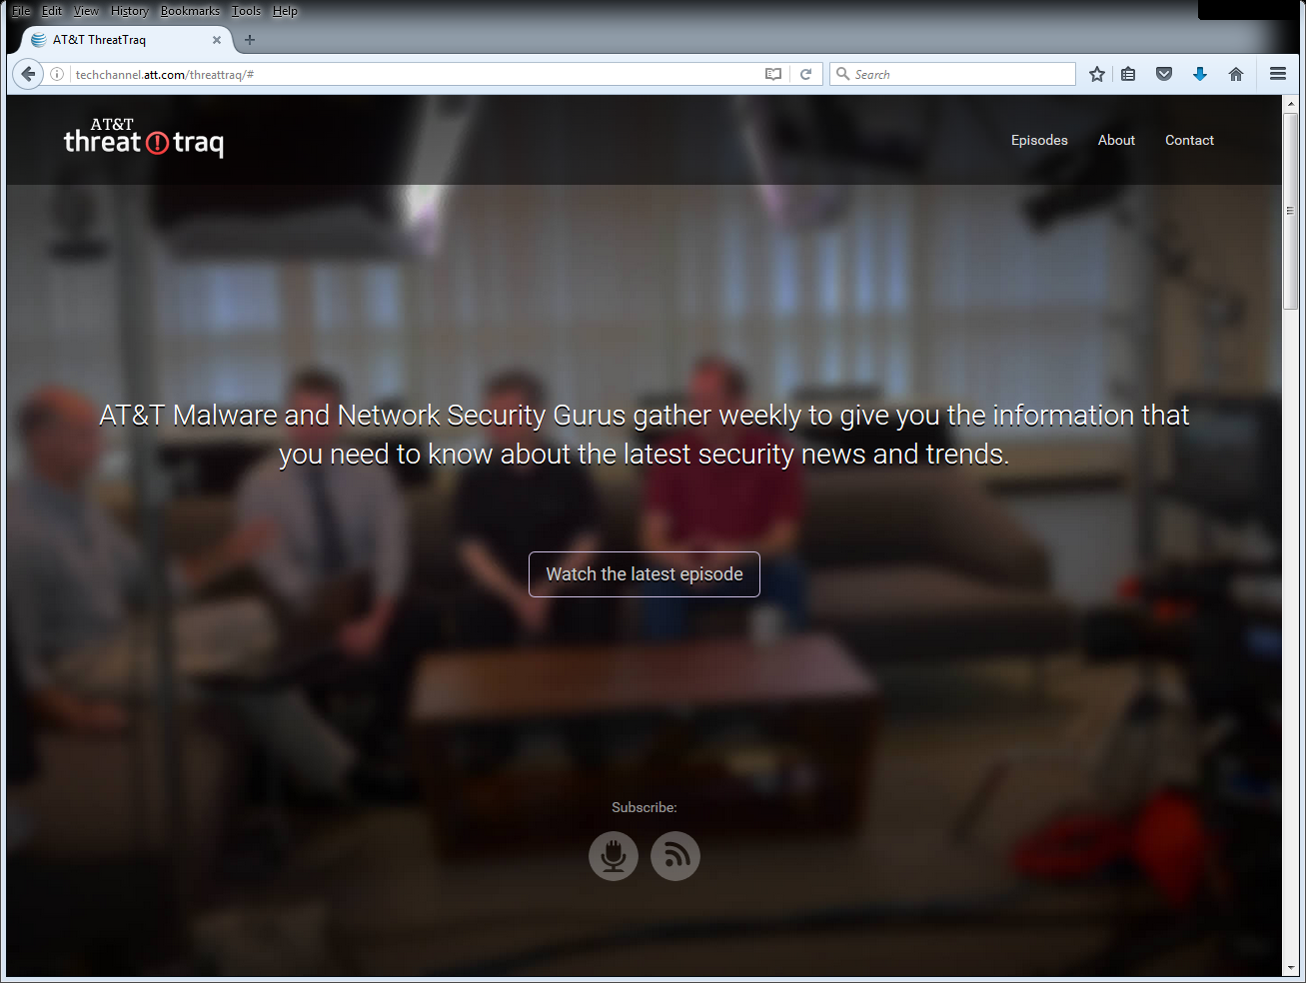
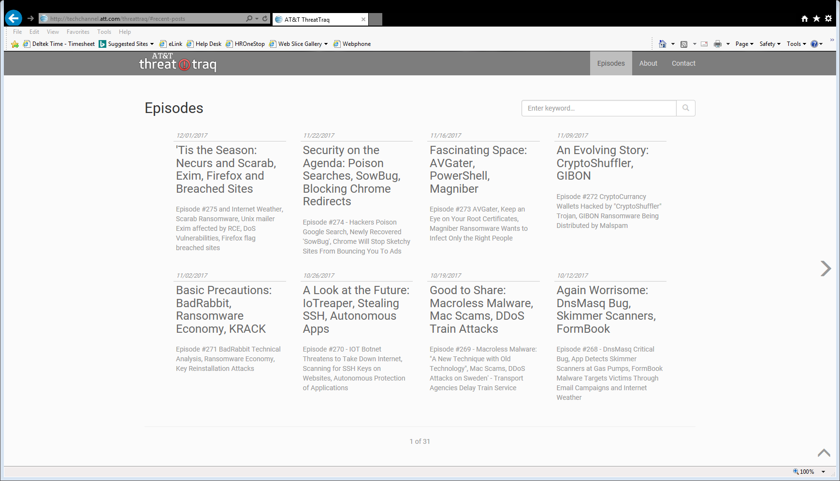
AT&T ThreatTraq Weekly Cyber Threat Report
source: http://techchannel.att.com/threattraq
Tis the Season: Necurs and Scarab, Exim, Firefox and Breached Sites

